Slide 1
Course Name: Database Management System
Course Code: CS116
Dr. Praveen Kantha

Slide 2
Transaction Processing

Slide 3
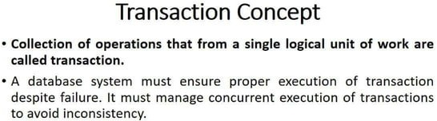

Slide 4
Properties of Transaction
ACID Properties
It is important to ensure that the database remains consistent before and after the transaction.
To ensure the consistency of database, certain properties are followed by all the transactions occurring in the system.
These properties are called as ACID Properties of a transaction.

Slide 5
1. Atomicity-
This property ensures that either the transaction occurs completely or it does not occur at all.
In other words, it ensures that no transaction occurs partially.
That is why, it is also referred to as “All or nothing rule“.
It is the responsibility of Transaction Control Manager to ensure atomicity of the transactions.
2. Consistency-
This property ensures that integrity constraints are maintained.
In other words, it ensures that the database remains consistent before and after the transaction.
It is the responsibility of DBMS and application programmer to ensure the consistency of the database.

Slide 6
3. Isolation-
This property ensures that multiple transactions can occur simultaneously without causing any inconsistency.
During execution, each transaction feels as if it is getting executed alone in the system.
A transaction does not realize that there are other transactions as well getting executed parallelly.
Changes made by a transaction become visible to other transactions only after they are written in the memory.
The resultant state of the system after executing all the transactions is the same as the state that would be achieved if the transactions were executed serially one after the other.
It is the responsibility of the concurrency control manager to ensure isolation for all the transactions.

Slide 7
4. Durability-
This property ensures that all the changes made by a transaction after its successful execution are written successfully to the disk.
It also ensures that these changes exist permanently and are never lost even if there occurs a failure of any kind.
It is the responsibility of the recovery manager to ensure durability in the database.

Slide 8
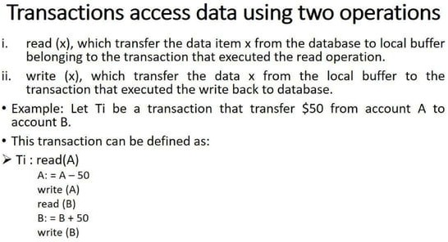

Slide 9
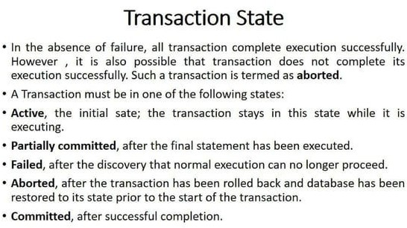

Slide 10
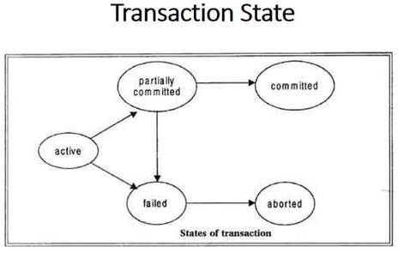

Slide 11
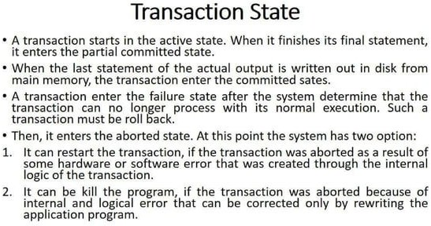

Slide 12
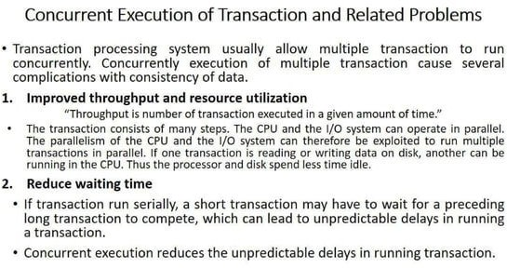

Slide 13
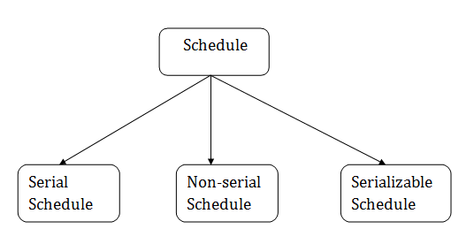
Introduction to Schedules
A series of operation from one transaction to another transaction is known as schedule.
It is used to preserve the order of the operation in each of the individual transaction.

Slide 14
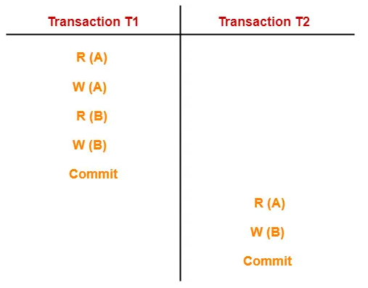
Serial Schedules
In serial schedules,
All the transactions execute serially one after the other.
When one transaction executes, no other transaction is allowed to execute.
In this schedule,
There are two transactions T1 and T2 executing serially one after the other.
Transaction T1 executes first.
After T1 completes its execution, transaction T2 executes.
So, this schedule is an example of a Serial Schedule.

Slide 15
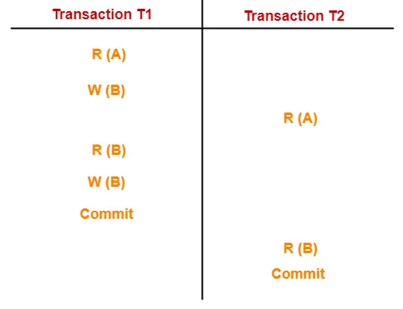
Non-Serial Schedules
In non-serial schedules,
Multiple transactions execute concurrently.
Operations of all the transactions are inter leaved or mixed with each other.
In this schedule,
There are two transactions T1 and T2 executing concurrently.
The operations of T1 and T2 are interleaved.
So, this schedule is an example of a Non-Serial Schedule.

Slide 16

Finding Number of Schedules
Consider there are n number of transactions T₁, T₂, T₃ …. , T_{n} with N₁, N₂, N₃ …. , N_{n} number of operations respectively.
Total Number of Schedules-
Total Number of Serial Schedules-
Total number of serial schedules
= Number of different ways of arranging n transactions
= n!
Total number of possible schedules (serial + non-serial) is given by-
Total Number of Non-Serial Schedules-
Total number of non-serial schedules
= Total number of schedules – Total number of serial schedules

Slide 17
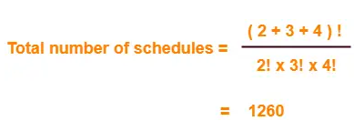
Problem-
Consider there are three transactions with 2, 3, 4 operations respectively, find:
How many total number of schedules are possible?
How many total number of serial schedules are possible?
How many total number of non-serial schedules are possible?
1. Total Number of Schedules-
Using the above formula, we have-

Slide 18
Total Number of Serial Schedules-
Total number of serial schedules
= Number of different ways of arranging 3 transactions
= 3!
= 6
Total Number of Non-Serial Schedules-
Total number of non-serial schedules
= Total number of schedules – Total number of serial schedules
= 1260 – 6
= 1254

Slide 19
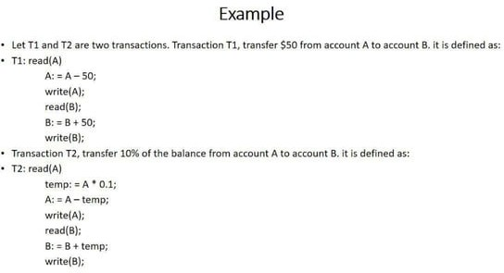

Slide 20
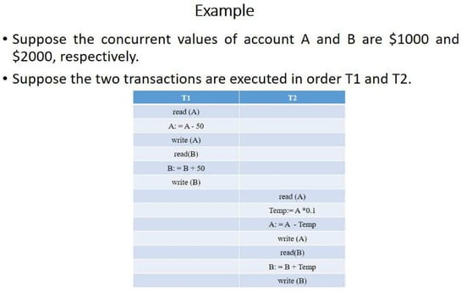

Slide 21
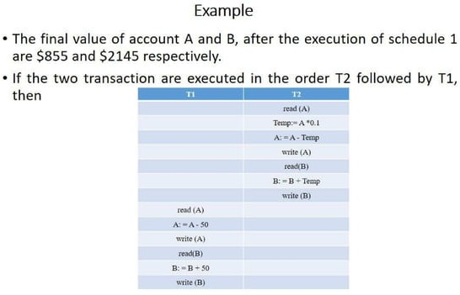

Slide 22
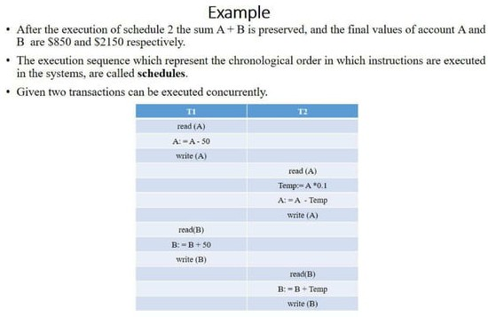

Slide 23
